Slide 1
NATO Logistics Education and Training

Slide 2
AGENDA
Aim
What do we have?
Who?
Process
Challenges
Way ahead

Slide 3
Aim of the briefing
To give students a brief overview on the Education and Training within NATO and the respective R&R of the different entities within the process.

Slide 4
What do we have?
MC 458/3 (Final), NATO Education, Training, Exercises and Evaluation (ETEE) Policy, dated 03 Sep 2014;
Bi-SC 75-7, EDUCATION and INDIVIDUAL TRAINING DIRECTIVE (E&ITD);
PO(2015)0099, NATO Logistics Strategic Training Plan, dated 17 Feb 15;
NATO LOGISTICS DISCIPLINE ALIGNMENT PLAN 2021;
MLCC Appointment as Department Head for Logistics, dated 04 Dec 15;
Logistics Training Requirements Analysis Final Report, dated 25 Nov 15.

Slide 5
Who?
Requirement Authority SHAPE
Department Head Mr Roman Dufek (MLCC)
JFD/Management and Evaluation ACT
OPRs ????
EFTs NSO/NCI Academy /MLCC/JCTC/JLEC….

Slide 6
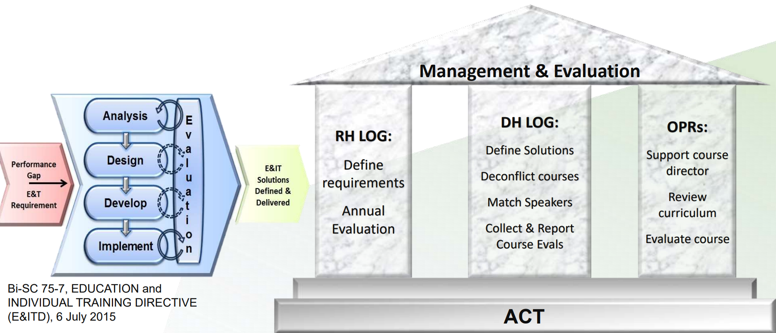
NATO Training and Education Landscape

Slide 7
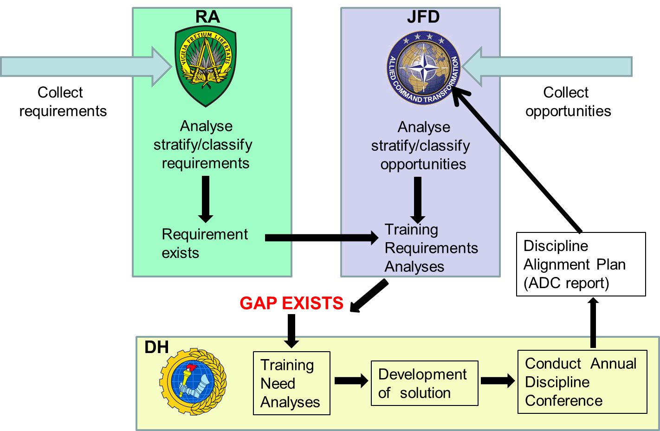
Management process overview

Slide 8
NATO Logistics Training and Education
DH, under HQ SACT JFD guidance:
Translates the operational requirements into education and training programmes within the discipline framework
Leads the Training Needs Analyses, supported by HQ SACT JFD and the RA (Requirement Authority);
Recommend changes to the RA (and if necessary to JFD);
Conduct and leads the Annual Discipline Conference (ADC)
Participate in the Production Planning Process and working groups when appropriate (Planning Boards and the Training Synchronization Conference) to align requirements with programmed education and training solutions.

Slide 9
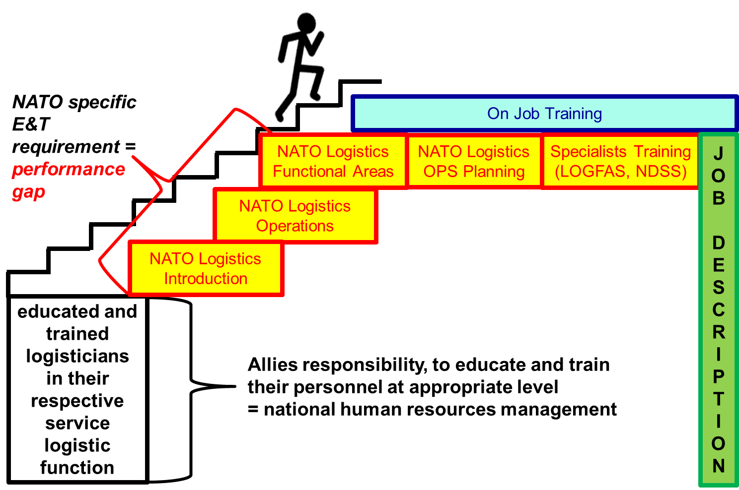
Addressing requirements

Slide 10
Essential (mandatory) courses
For all NATO LOG positions:
NLIC – NATO Logistics Introductory Course NSO, MLCC, FINCENT
NLOC - NATO Logistics Operational Course NSO, MLCC
Specialized courses for SMEs:
NATO Logistics Operational Planning course NSO
NATO Host Nation Support course NSO
NATO Movement &Transportation Course NSO
NATO Petroleum Strategic course NSO
LOGFAS courses NCI Academy, MLCC, JLEC, JCTC

Slide 11
Desired (complementary) courses
JLSG HQ Orientation courses MLCC, JCTC
RSOM - Orientation course MLCC (+JLEC)
RSOM - Advanced course MLCC (+JLEC)
Other courses:
Logistics Staff Orientation Course TUR PTEC

Slide 12
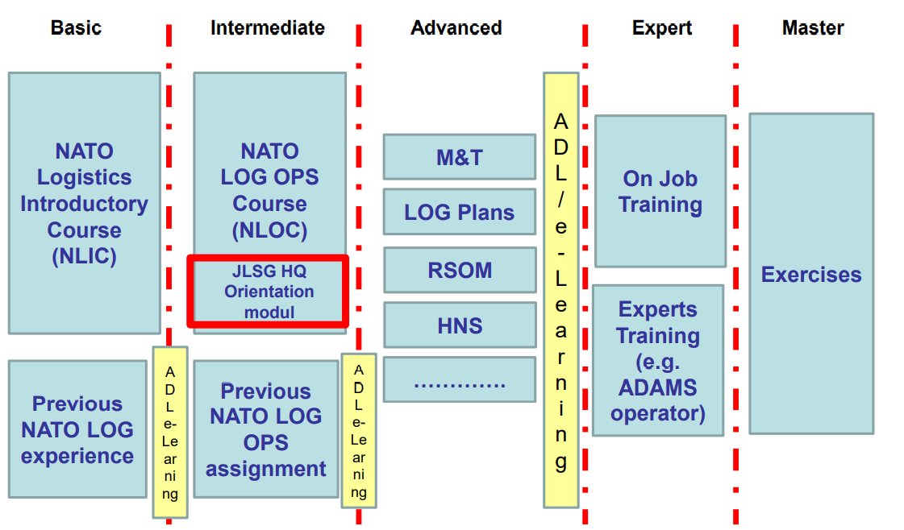
Proficiency development

Slide 13
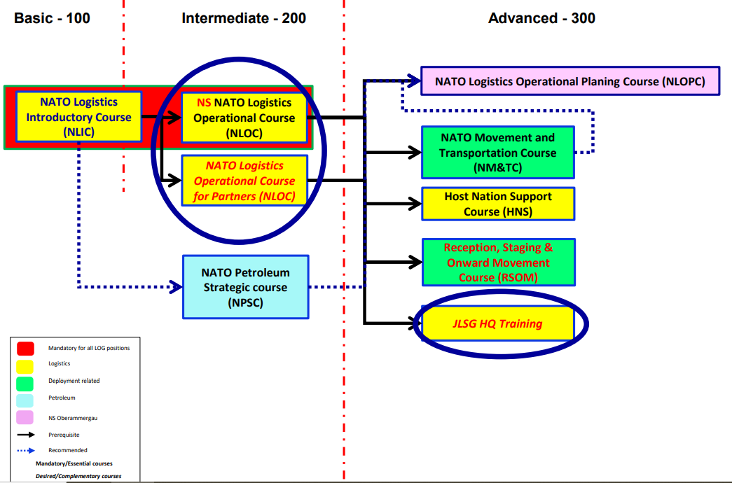
2023 log training path development

Slide 14
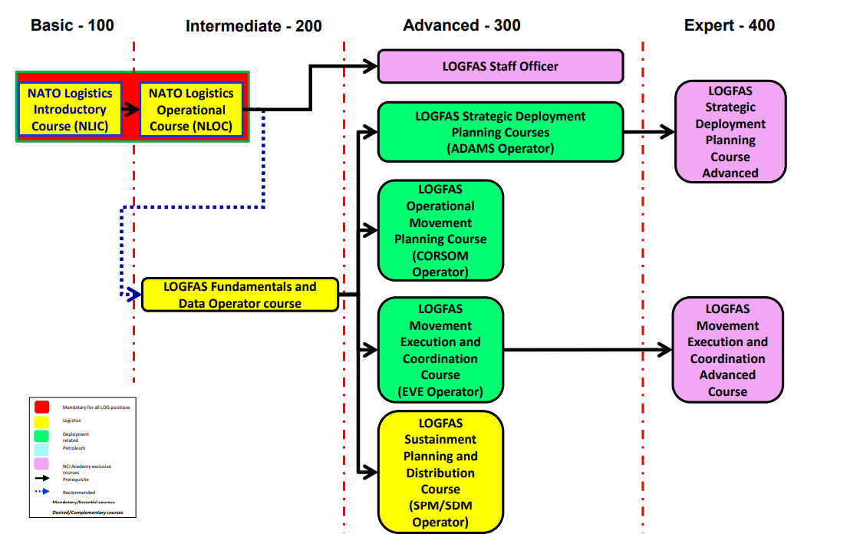
LOGFAS Training Path

Slide 15
Basic - 100
Intermediate - 200
Advanced - 300
Expert - 400
NATO Logistics Operational Planing Course (NLOPC)
NATO Logistics Introductory Course (NLIC)
NATO Logistics Operational Course (NLOC)
NATO Movement and Transportation Course (NM&TC)
2022 LOG training path
JLSG HQ Orientation Course
Host Nation Support Course (HNS)
NATO Petroleum Strategic course (NPSC)
NATO Petroleum Operational Management Course (NPOMC)
Reception, Staging & Onward Movement Orientation Course (RSOM OC)
Reception, Staging & Onward Movement Advanced Course (RSOM AC)
LOGFAS Information Management Course
(LOGFAS Staff Officer)
LOGFAS Fundamentals and Basic Data Operator course
LOGFAS Strategic Deployment Planning Courses
(ADAMS Operator)
LOGFAS Strategic Deployment Planning Courses Advanced
LOGFAS Operational Movement Planning Course
(CORSOM Operator)
Mandatory for all LOG positions
Logistics
LOGFAS Movement Execution and Coordination Course
(EVE Operator)
LOGFAS Movement Execution and Coordination Manager Course
Deployment related
Petroleum
NCI Academy exklusive courses
Prerequisite
LOGFAS Sustainment Planning and Distribution Course
(SPM/SDM Operator)
Recommended

Slide 16
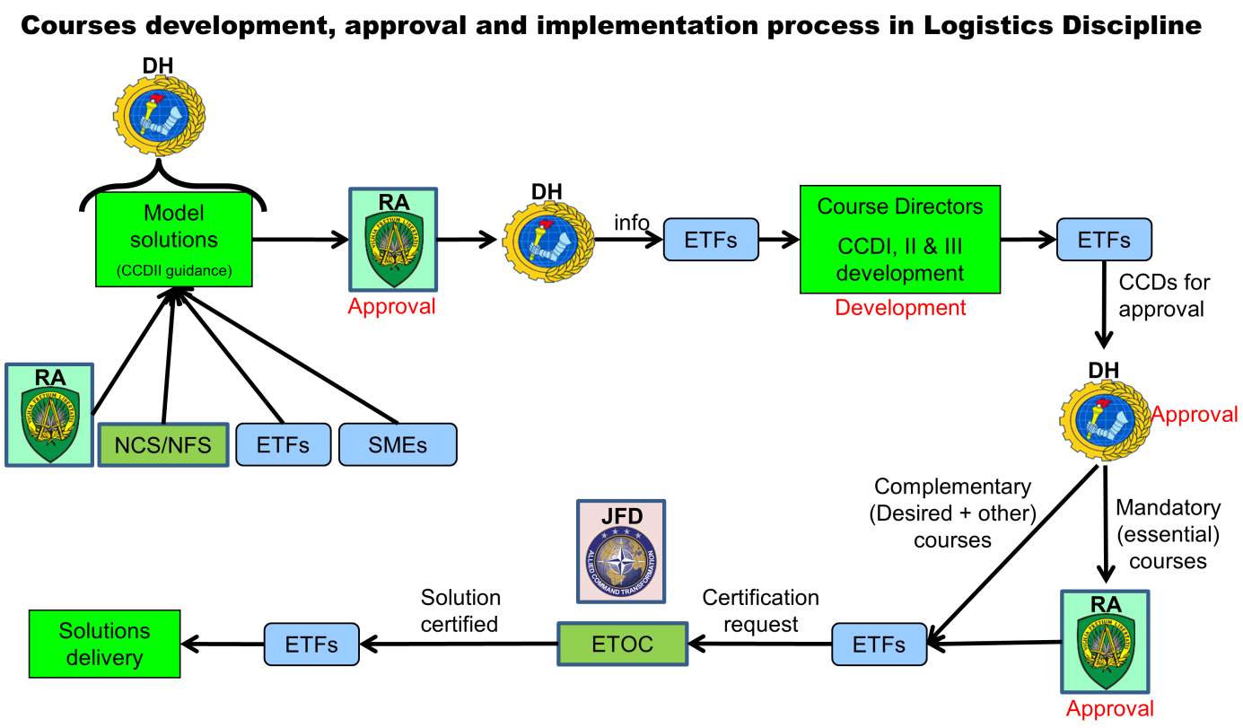
Solutions development

Slide 17
Course Certification
step 1) add course to ETOC to get the course code and develop CCDs based on RA (ACOS J4) approved model solutions
step 2) consult all 3 CCDs developed with DH LOG
step 3) finalize CCDs and send them to DHLOG with CCD1 signed by the Course Director and Academy Commander
step 4) DH LOG will sign CCD1 and send all 3 CCDs to RA
step 5) RA signs CCD1 and sends back to DH LOG
step 6) DH LOG sends CCD1 to ETF
step 7) ETF uploads CCDs to ETOC and request certification
step 8) ACT will check the course upon TRA and decide on certification
step 9) you will receive a letter from ACD JFD about certification and it will be also managed in ETOC

Slide 18
Way Ahead
Support RA (ACO) in conducting the new TRA to reflect adaptation of NATO Command Structure and significant changes in the security environment
Implement LOGFAS training path and model solutions for future LOGFAS 7 courses
Continue coordination with the NATO School in Oberammergau, NCI Academy in Oeiras and other ETFs (MLCC, JCTC, JLEC, FINCENT) to deliver required solutions
Deepen DH LOG engagement in NATO exercises
Integrate POL planning in NLOPC and ESMRM planning integrate in NLOPC
eNLIC 24/7 at 365 days a year available
Align training and exercise planning
List of OPRs/SMEs in support of

Slide 19
Questions

